Slide 1

GEEHY SEMICONDUCTOR

Slide 2
New product preview
Contents:
New product:
Ultra-Low-Power APM32L072
Dedicated Motor MCU APM32F035
Digital Analog Hybrid SoC BMP1601
Mainstream series APM32S103x8/xB
Ecological forum:
Github: https://github.com/GeehySemi
Hackster:https://www.hackster.io/geehy-semiconductor1/

Slide 3
Ultra-Low-Power APM32L072
APM’s ultra-low-power MCU platform is based on a proprietary ultra-low-leakage technology and optimized design.APM32L0x ultra-low-power microcontrollers offer designers of energy-efficient embedded systems and applications a balance between performance, power, security and cost effectiveness.
Features
System
Arm® 32-bit Cortex®-M0+
From 32 kHz up to 32 MHz max.
Memory
Up to 192-Kbyte Flash
20 -Kbyte RAM
6 Kbytes of data EEPROM
Communication Peripherals
2x SPI
3x I2C
1x USB 2.0
4x USART
1x LPUART (low power)
Timers
4x Universal timer
2x Basic timer
1x 16-bit ultra-low-power timer
2x watchdogs (independent/window)
LCD
4x52 or 8x48 segments
Package
LQFP32
LQFP48
LQFP64
LQFP100

Slide 4
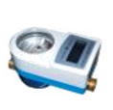
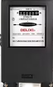
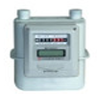
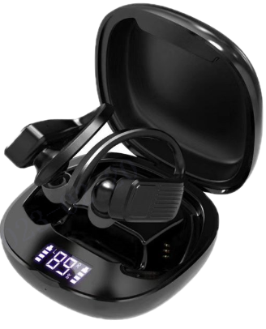
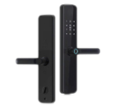
Application block diagram
Typical Application
water meter
power meter
LCD
UART
Display
APM32L072
MBUS
Dry spring tube
Timer
UART
NB-IOT
Touch control
TSC
gas meter
Headphone charging box
SPI/IIC
GPIO
IC card
Buzzer
ADC
GPIO
Battery
LED
Smart door lock
Other Low Power Products
some sensors, etc.

Slide 5
Dedicated Motor MCU APM32F035
The cost-effective dedicated motor MCU will come with low power consumption, high stability, and high integration. It has built-in rich high-precision analog peripherals and communication interfaces, effectively improving motor control performance and reducing costs.
System
Arm® 32bit Cortex®-M0+
Working frequency:72MHz
Hardware coprocessor:CRC,Cordic,
SVPWM,32/32-bit divider,square boot
Memory
SRAM:8KB
ROM:64KB
Analog Peripherals
12-bit ADC:1Msps, 16 channels
OP:4 units, supports internal programmable
gain and external gain conﬁguration
CMP:2 units, can be used with internal
OPA output
DMA:7 channels
Communication Peripherals
I2C:1
SPI/I2S:1
CAN:1
UART:2
IR:1
Timers
Advanced timer: 1
Universal timer: 3
Basic timer: 2
Package
LQFP32
LQFP48

Slide 6
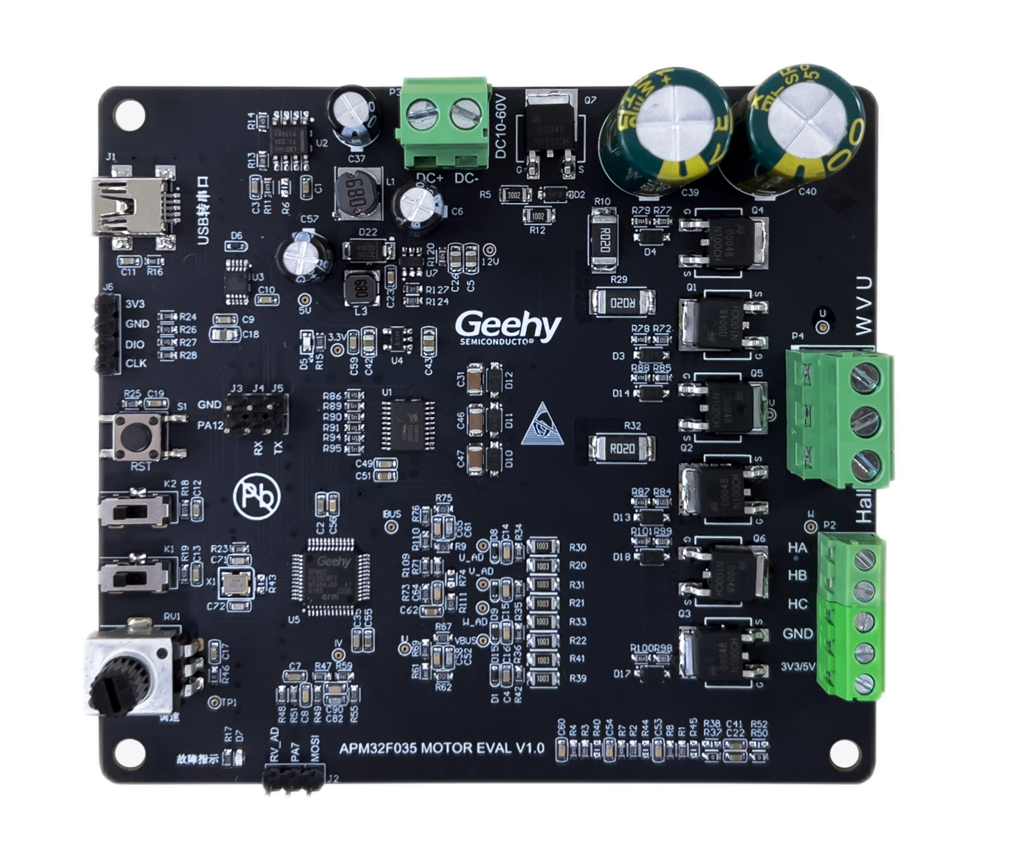
Motor drive block diagram
One-Stop Motor Control Development Ecology
Motor Control Algorithm Platform,Upper Computer Debugging Platform,High/Low Voltage
Motor Development Kit,Effcient Algorithm-Driven Library,Motor Control Routines
Motor Evaluation Board
Power
Regulator
DC
Power
12V
MOTOR
Gate
Driver
Power
MOSFET
Phase current
Bemf
APM32F035
TMR1
OPA
ADC
PC
debugging
software

Slide 7
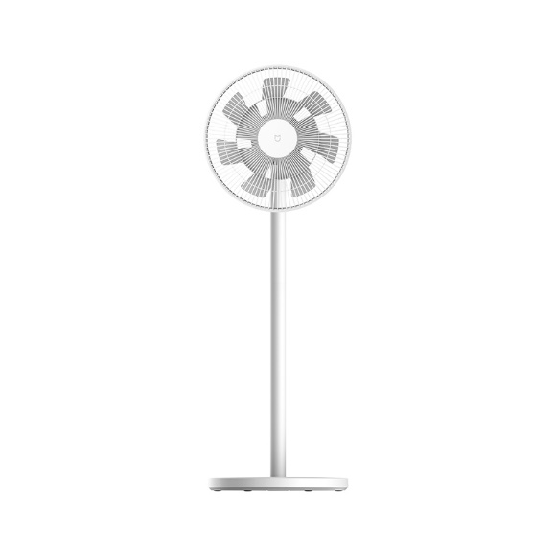
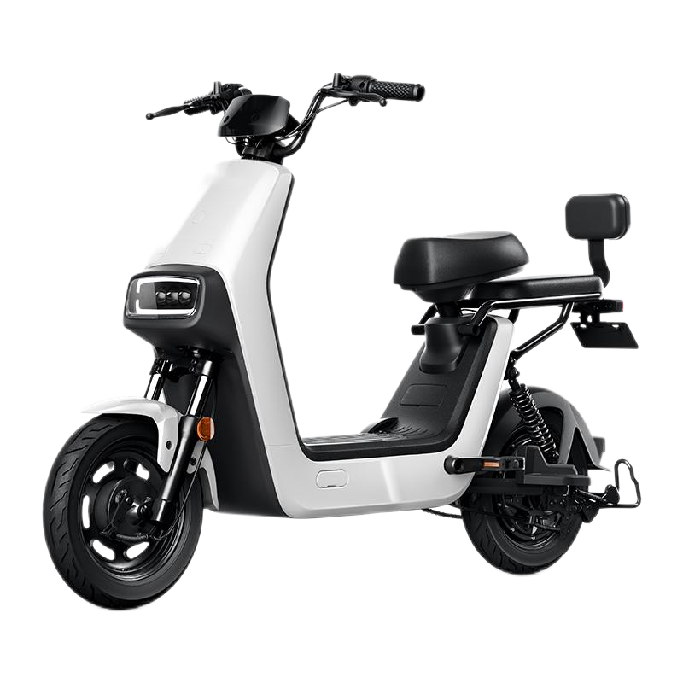
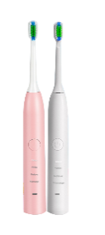
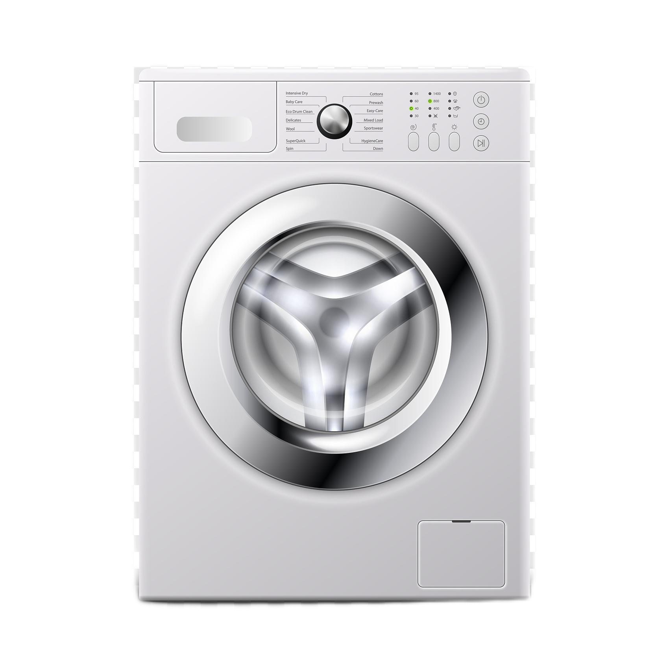
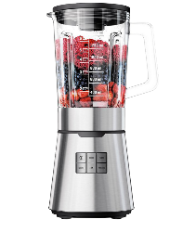
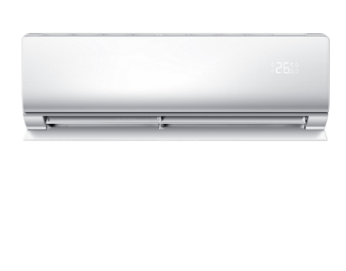
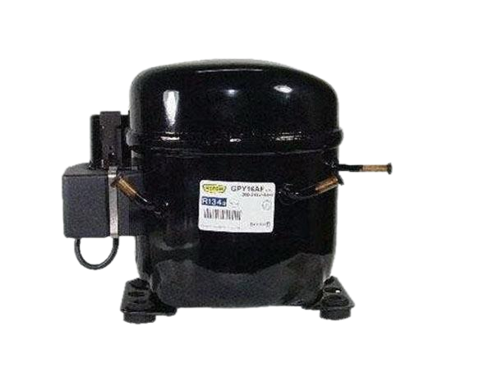
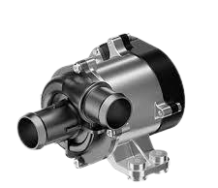

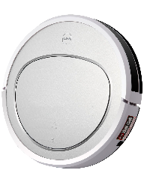

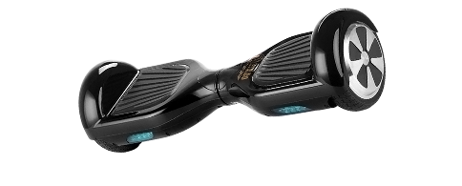
Typical Application
E-Bikes/Tricycles
Toothbrush
Fans
Washing Machines
Soymilk machine
air conditioner
balance car
refrigerator compressor
water pump
clean Robot
Power Tools

Slide 8
Digital Analog Hybrid SoC BMP1601
It supports more than 20 kinds of diversiﬁed protection functions, integrates high-precision analog peripherals and high-eiciency voltage/current/temperature acquisition and detection modules, and supports ultra-low-power operation mode and 5~16 string Li-ion batteries to efectively guarantee the stable operation of BMS system and accelerate the transformation and upgrading of the new energy structure.
Features
Diversiﬁed Functions
Balance
20 kinds of hardware
Precharge/Predischarge
Force to open charge anddischarge MOS
Low Power Design
MIDLE
Low Speed
Sleep
Low Power
Working Mode
Reset
Off
Self-protection
External Regulation
High Integration
Watchdog
MTP
I2C
Regulated power supply 3.3V
16-bit Σ-ΔTCADC
6-channel temperature acquisition,
1-channel current acquisition
Temperature acquisition input
range: -1.5~1.5V
Current acquisition input
range: -1.5~1.5V
16-bit Σ-ΔVADC
16-channel voltage
acquisition
Voltage acquisition input
range: -0~5V
16-bit Σ-ΔCADC
1 channel current acquisition
Current acquisition input
range: -0.25V~0.25V
Package
TQFP48

Slide 9





Application block diagram
Typical Application
Home Energy Storage
Base Station UPS
Portable Energy Storage
High Voltage Industrial
Energy Storage System
E-Bike/Tricycle
FUSE
PACK+
Circuit Protection
Vbat
BMP1601
Temperature
BAT*(5-16)
Single charge control
IIC
MCU
Alarm
Current sensing
PACK-
Resistance

Slide 10
Mainstream series APM32S103x8/xB
Based on a 32-bit Arm® Cortex®-M3 core, the APM32S103x8xB series MCUs come with computing frequency up to 96MHz and a working temperature range of -40℃ to +105℃, helping products operate stably in industrial-grade temperature scenarios. With enhanced peripheral functions and 2 built-in CANs, it supports dual CAN operation at the same time.
Features
Core：Arm®32-bit Cortex®-M3
Frequency ：96MHz
FLASH： 128KB
SRAM： 36KB
Working Voltage： 2.0V~3.6V
Working Temperature： -40℃~105℃
Communication Peripherals
I2C: 2
USART: 3
SPI:2
CAN: 2
USBD: 1
Package
1）LQFP100——APM32S103VBT6
2）LQFP64——APM32S103RBT6
3）LQFP48——APM32S103CBT6、C8T6
3）QFN36 ——APM32S103TBU6
Timer
16-bit advanced timer: 1
16-bit universal timer: 3
Watchdog timer: 2
SysTick: 1

Slide 11
APM32S103x8/xB resource comparison
Part number |  | APM32S103x8/xB | APM32F103x8xB | Sxx32F103x8xB
Core |  | Cortex-M3 | Cortex-M3 | Cortex-M3
Frequency |  | 96MHz | 96MHz | 72MHz
Flash |  | 64/128KB | 64/128KB | 64/128KB
RAM |  | 36KB | 20KB | 20KB
Working Voltage |  | 2.0~3.6V | 2.0~3.6V | 2.0~3.6V
Working Temperature |  | -40~105°C | -40~105°C | -40~105°C
ESD | HBM | 5.5 KV | 4.5 KV | 3.5KV
 | CDM | 800 V | 2 KV | 900V
Timer | general | 3 | 3 | 3
 | advanced | 1 | 1 | 1
 | basic | 0 | 0 | 0
peripheral interface | SPI | 2 | 2 | 2
 | QSPI | 1 | 1 | 0
 | I2C | 2 | 2 | 2
 | USART | 3 | 3 | 3
 | USB Device | 1 | 1 | 1
 | CAN | 2 | 1 | 1
 | FPU | 1 | 1 | 0
 | GPIOs | 26/37/51/80 | 26/37/51/80 | 26/37/51/80
12-bit ADC |  | 2 | 2 | 2
（Channel） |  | 16 | 16 | 16
12-bit DAC |  | 0 | 0 | 0
Package |  | QFN36 LQFP48/64/100 | QFN36 LQFP48/64/100 | QFN36/48 LQFP48/64/100 BGA 64/100
USB and CAN can be used at the same time
CAN1 and CAN2 can work at the same time.

Slide 12

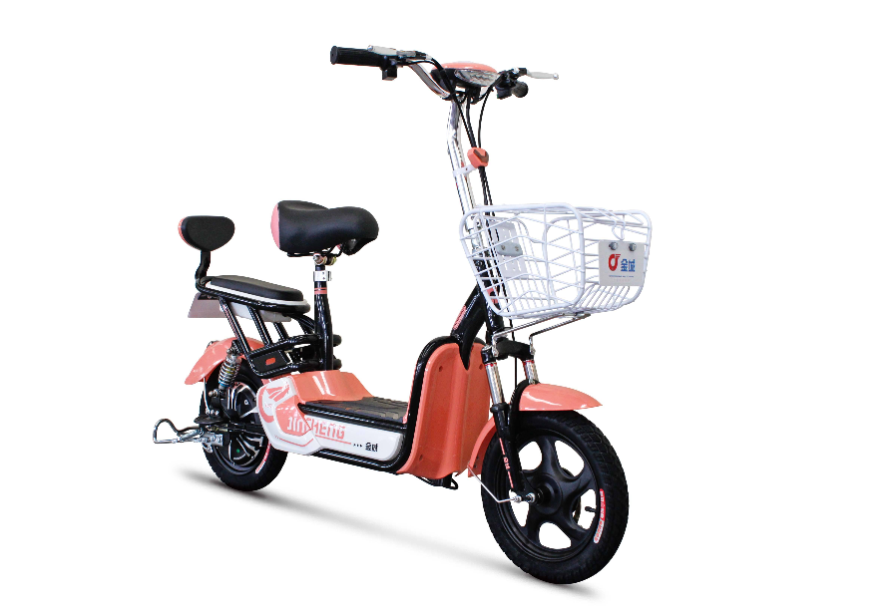

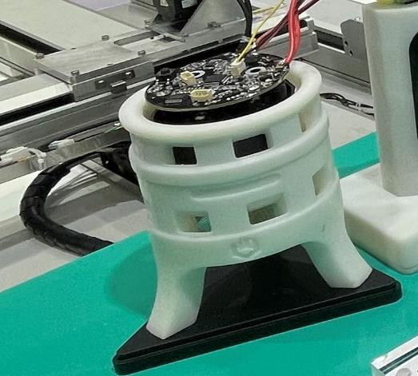
Application block diagram
Typical Application
small consumer products
Smart home Industrial
I2C
UART
EEPROM
APM32S103
Debug
Timer
Motor
BMS
CAN
SPI
GPIO
OLED
Buzzer
ADC
GPIO
Sensor
LED

Slide 13


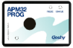


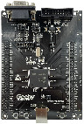
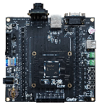









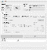
Friendly Ecosystem for Development
With a complete ecosystem, Geehy can provide a wealth of software and hardware development tools, helping engineers to accelerate product development, reduce development costs, and optimize product performance.
Technical Support
Selection Tool
Technical Doc
Samples Support
Services
Support
Development & Design
Official Tools
Selection guide
Online selection tool
Datasheet
User manual
Application note
FAQ
Chip
Demo board
Sales
FAE
AE
IDE
Programing Tool
Debug Tool
Partner Tools
Ecological Platform
Programing Tool
Geehy
Github
Hackster
MCAL
SDK
MINI Board
EVAL Board
Training & Promotion
Campus Ecology
Reliability Test
Security Lib
ISP
Webinar
Online
Live
Offline Training
Graduate
Training
Briefing Session
Design Competition
Notes:
With a complete ecosystem, Geehy can provide flexible, convenient, easy-to-use, rich, and diverse development tools, both software and hardware. And we also provide an ecological platform to provide engineers with excellent user experience, help Geehy customers to shorten product design cycle, reduce development costs, and then achieve optimal performance.

Slide 14
THANKS

